Slide 1
An Intro to Android Development – Android Studio
Shaastra Online Workshop Series presents,
- By
Monish Kumar V

Slide 2
What is Android and Android Studio?
Android is an open source and Linux-based Operating System for mobile devices such as smartphones and tablets. Android was developed by the Open Handset Alliance, led by Google, and some other companies.
Android Studio is an integrated development environment (IDE). It is a software that is used to build apps that are compatible with the Android OS.

Slide 3
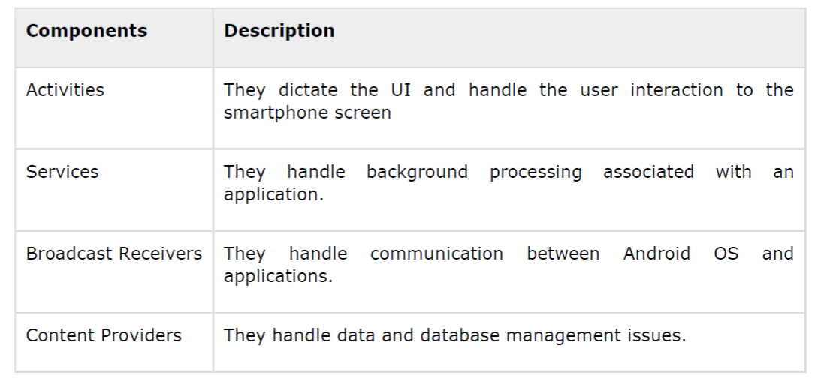
Components of an Android Application

Slide 4
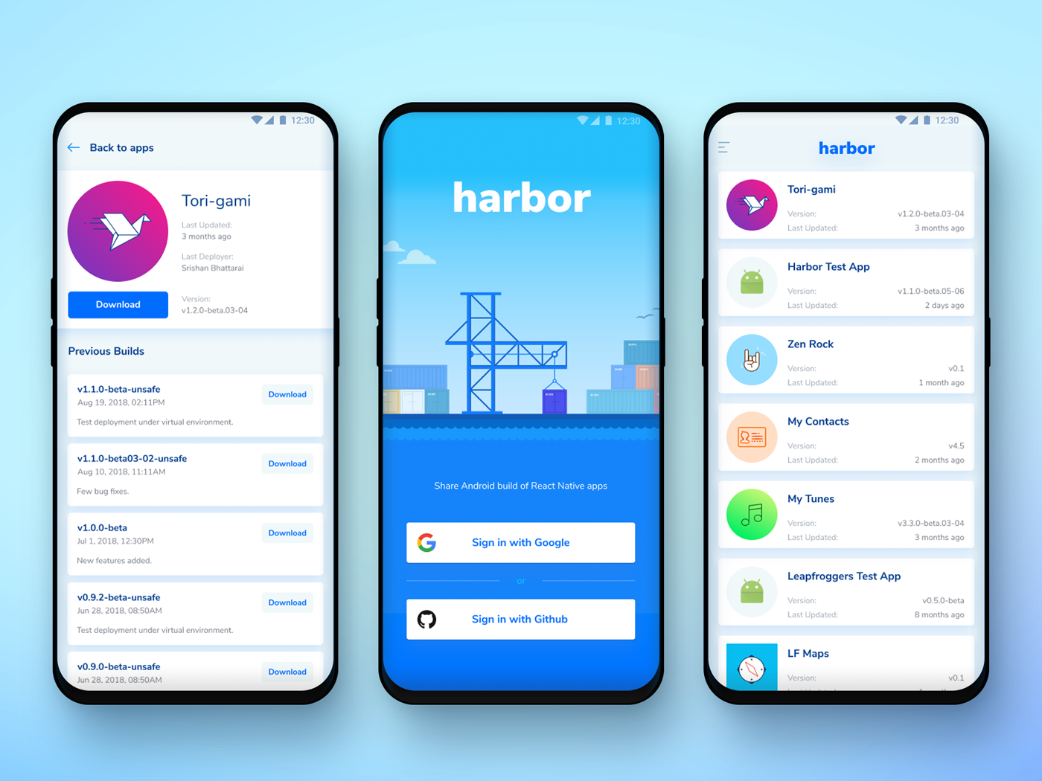
Activities
An activity represents a single screen with a user interface.
For example, an email application might have one activity that shows a list of new emails, another activity to compose an email, and one for reading emails.
If an application has more than one activity, then one of them should be marked as the activity that is presented when the application is launched.
TLDR: Any screen you come across in an android app is an ‘Activity’

Slide 5
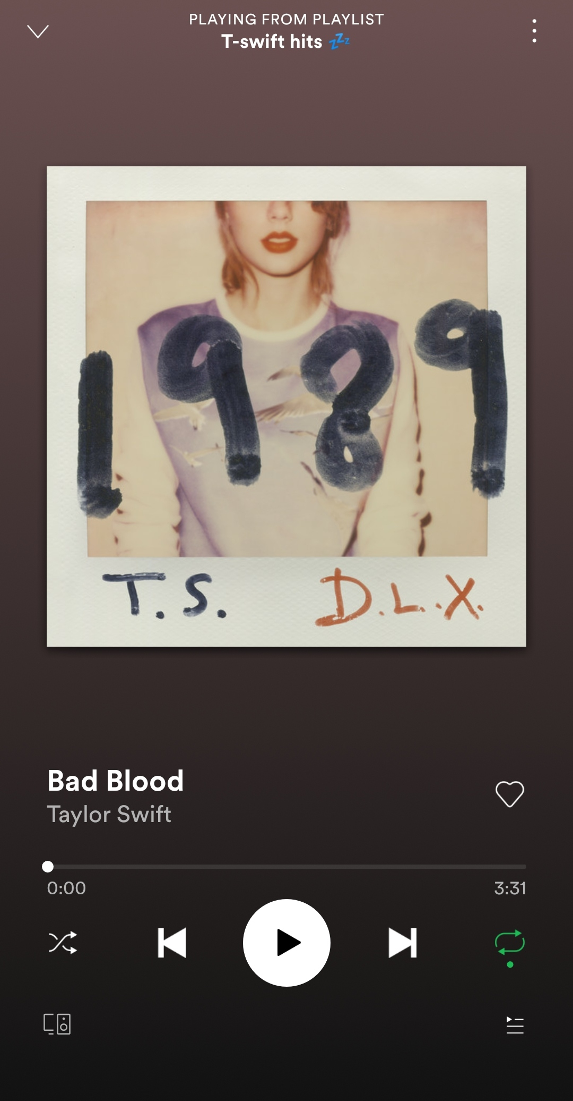
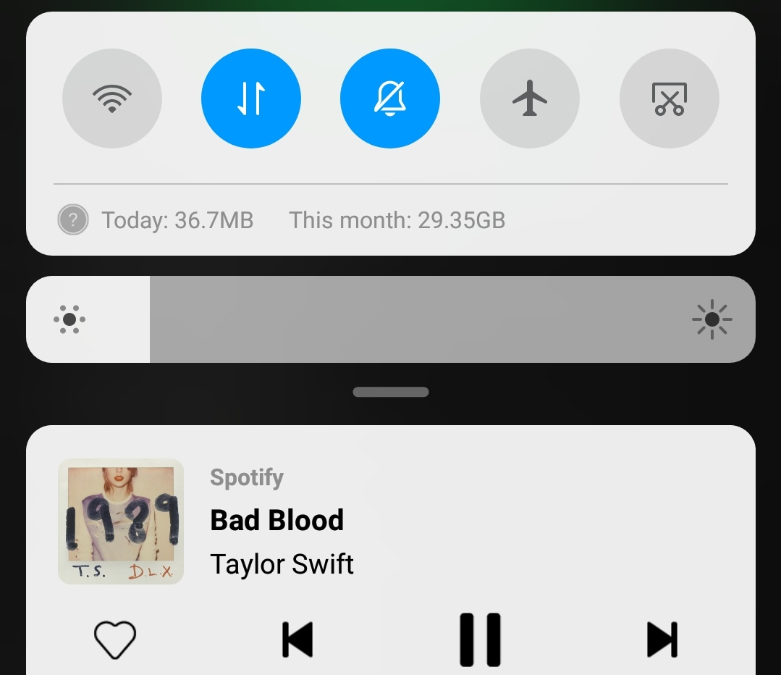
Services
A service is a component that runs in the background to perform long-running operations.
For example, a service might play music in the background while the user is in a different application, or it might fetch data (example: downloading) over the network without blocking user interaction with an activity.
Unlike an activity, a service doesn’t have an user interface (UI).
A service stops running once the app is shutdown (i.e. removed from recent tab history).

Slide 6
Broadcast Receivers
Android apps can send (or) receive broadcast messages from the Android system (or) other Android apps. These broadcasts are sent when an event of interest occurs.
For example, the Android system sends broadcasts when various system events occur, such as when the system boots up or the device starts charging.
Apps can also send custom broadcasts, for example, to notify other apps of something that they might be interested in (for example, some new data has been downloaded).
Apps can register to receive specific broadcasts. When a broadcast is sent, the system automatically routes these broadcasts to apps that have subscribed to receive that particular type of broadcast.

Slide 7
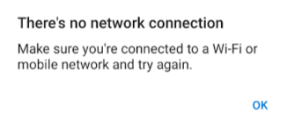
Broadcast Receivers (contd.)
Can be invoked when even when an app is not running.
Example: Notifications when you receive a message, alert messages when your network connectivity changes (Wi-Fi on/off, airplane mode,…) etc.

Slide 8
Content Providers
As the name suggests, they provide content (data) to an application.
Content providers can help an application manage access to data stored by itself or stored by other apps or provide a way to share data with other apps.
They encapsulate the data, and provide mechanisms for defining data security. Content providers are the standard interface that connects data in one process with code running in another process.
Content providers let you centralize content in one place and have many different applications access it as needed. Example: WhatsApp and Phone directory app
A content provider behaves very much like a database where you can query it, edit its content, as well as add or delete content using insert(), update(), delete(), and query() methods. In most cases this data is stored in an SQlite database.

Slide 9
Other popular terms every android developer comes across..

Slide 10
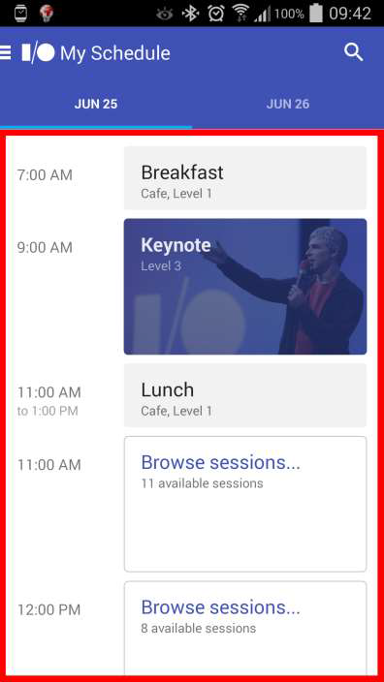
Fragments
You can think of a fragment as a modular section of an activity, which has its own lifecycle, receives its own input events, and which you can add or remove while the activity is running (sort of like a "sub activity" that you can reuse in different activities).
You can combine multiple fragments in a single activity to build a multi-pane UI and reuse a fragment in multiple activities.
It has its own layout, behavior and lifecycle callbacks, but it is killed/stopped if the activity is too.

Slide 11
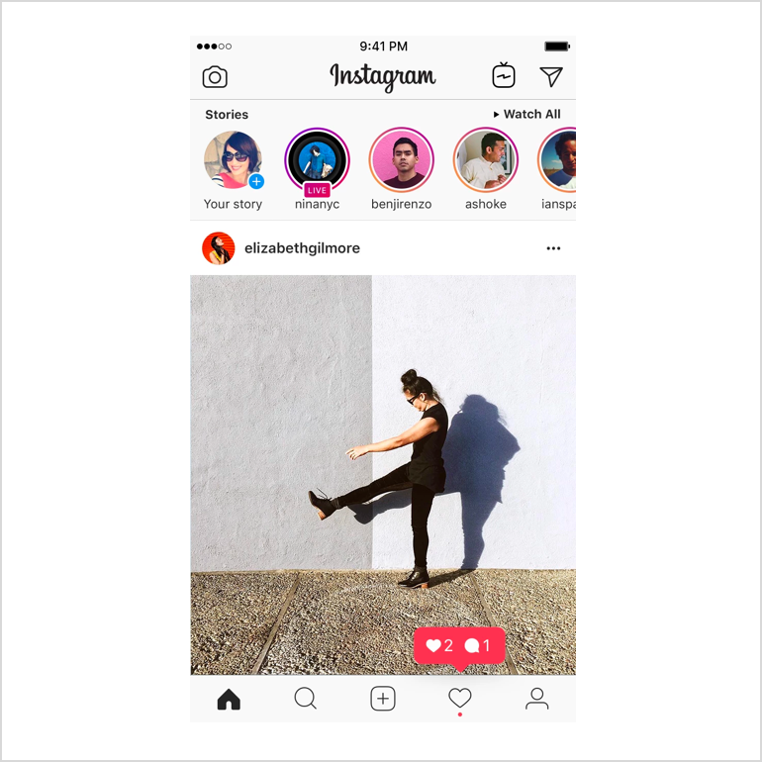

Slide 12
Intent
An Intent is an abstract description of an operation to be performed.
In simple terms, intent is an messaging object which is passed between components like services, content providers, activities etc.
It is basically a passive data structure holding an abstract description of an action to be performed.
Its most significant use is in the launching of activities or moving between one activity to another.
Actions performed by intents (other than launching activities): sending info to broadcast receivers, communicating with background services (pause and play buttons in music players) and many more…
NOTE: The above mentioned intent actions can be performed two different apps or within the same app itself.

Slide 13
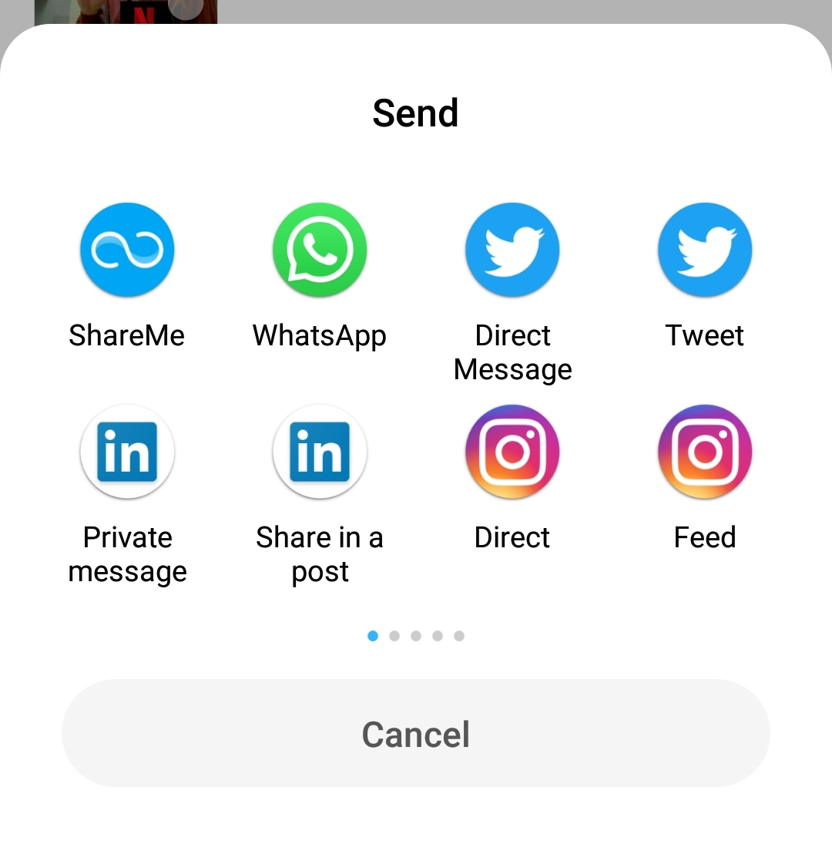
Types of intents
There are two types of intents in android: implicit and explicit.
Implicit Intent: While using an implicit Intent component, the component to which you are sending a particular message is not specified. An action to be performed is declared by implicit intent. Then android operating system will filter out component which will respond to the action and lets user decide the target component. (Ex: Sharing photos from your Gallery app).
Explicit Intent: While using an explicit intent the target component is specified. So only the specified target component will be invoked. (Ex: Moving between Activities).

Slide 14
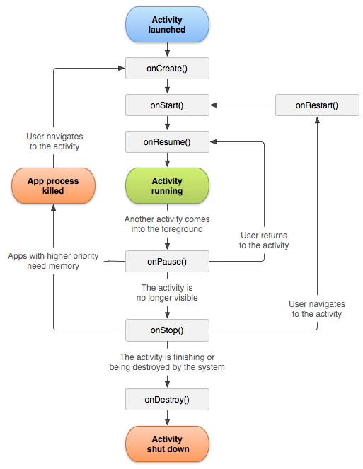
Android App Lifecyle
As a user navigates through, out of, and back to your app, the Activity instances in your app transition through different states in their lifecycle. The Activity class provides a number of callbacks that allow the activity to know that a state has changed: that the system is creating or stopping or resuming or destroying the process in which the activity resides.
To navigate transitions between stages of the activity lifecycle, the Activity class provides a core set of six callbacks:
onCreate()
onStart()
onResume()
onPause()
onStop()
onResume()

Slide 15
Setting up the environment for development
Install Java - Java SE 11 (LTS)
Install Android Studio
Install a Virtual Device (or) you could connect your mobile phone via a USB cable

Slide 16
Hello World Example – An App Overview

Slide 17
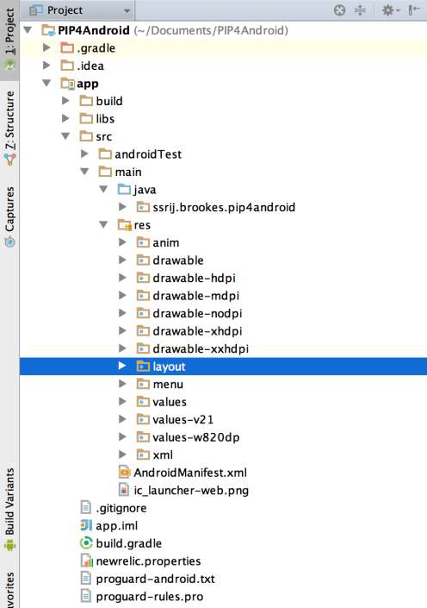
Project Structure
java: Java class files containing app logic
res: Different resource files
anim: Animation resource files
drawable: Images
drawable-xdpi: Images depending on screen density
layout: App layout files
menu: Layout menu files
values: Value files (strings, colors, arrays, etc)
xml: XML files
AndroidManifest.xml: App metadata file
build.gradle: Build related settings

Slide 18
Android User Interface (XML)

Slide 19
View and ViewGroups
View: The basic building block for user interface is a View object that is created from the View class and occupies a rectangular area on the screen. Views are the base class for UI components like TextView, Button, EditText, ImageView, etc…
ViewGroup: The ViewGroup is a subclass of View. One or more Views can be grouped together into a ViewGroup. A ViewGroup provides the android layout in which we can order the appearance and sequence of views. Examples of ViewGroup are LinearLayout, FrameLayout, RelativeLayout etc.

Slide 20
Attributes (to name a few…)
id – The convention is to use @+id/mybutton
Layout width and height – Ex: 20dp, match_parent, wrap_content
textSize (recommended to use sp as units), textColor, textStyle, fontFamily
visibility
margin v/s padding
gravity (alignment) – fill, centre, centre_horizontal, centre_vertical, top, bottom, left, right, etc…
src & background (both have the same purpose) – pictures are usually saved in the drawable folder. You can also set the image content based on a URI from a content provider via setImageURI() in your Java file.
onClick

Slide 21
Layouts (the popular ones..)
RelativeLayout: RelativeLayout enables you to specify how child views are positioned relative to each other. The position of each element (view) can be specified as relative to sibling elements (such as to the left-of or below another view) or in positions relative to the parent RelativeLayout area (such as aligned to the bottom, left or center). Example: android:layout_toRightOf="@+id/button1"
LinearLayout: Android LinearLayout is a view group that aligns all children in either vertically or horizontally in the same order of creation.
ConstraintLayout: ConstraintLayout, which is now the default layout in Android Studio, gives you many ways to place objects. You can constrain them to their container, to each other or to guidelines. This allows you to create large, complex, dynamic and responsive views in a flat hierarchy.

Slide 22
Thank You…
Up next: a Simple app with a login page

